Slide 1
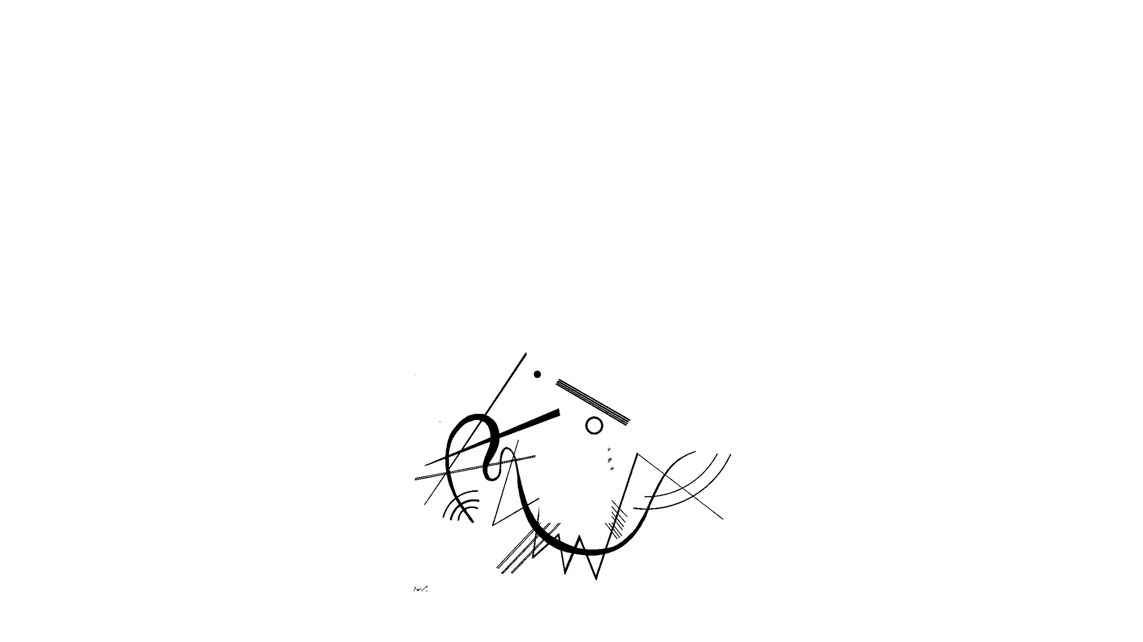
What line drawings reveal about the visual brain
Bilge Sayim and Patrick Cavanagh, 2011. Laboratoire Psychologie de la Perception, Centre Attention Vision, Université Paris Descartes, Paris, France
“Untitled (drawing for Diagram 17)” by Vassily Kandinsky. 1925.

Slide 2
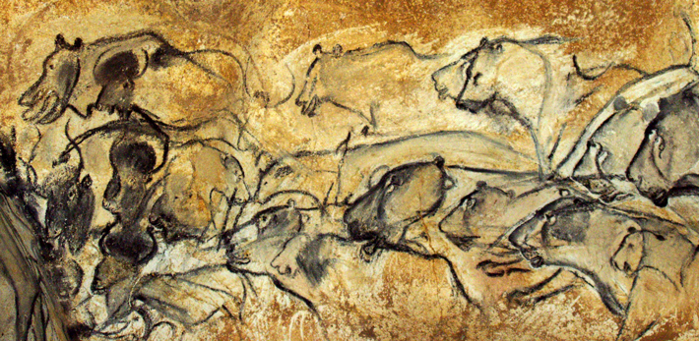
Chauvet Cave, France, Inhabited 37k-28k BC

Slide 3


Slide 4
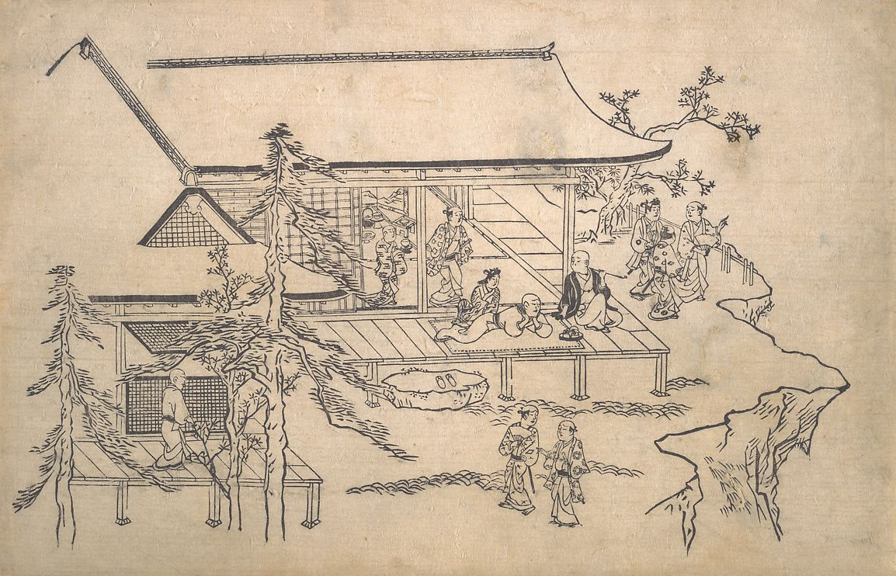
Why does the visual system understand line drawings?
“Flower-Viewing Scene” by Hishikawa Moronobu. Ca. 1685.

Slide 5
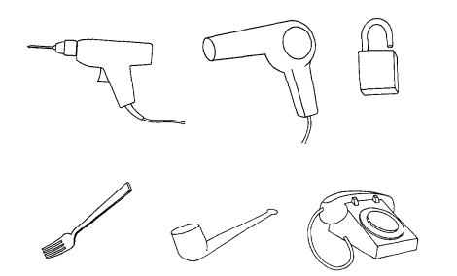
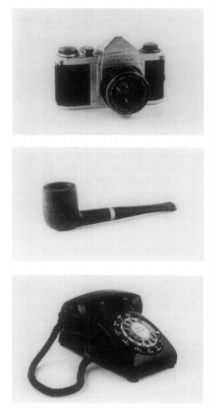
Line Drawings vs. Color Photos
Mean reaction times and error rates are identical for object recognition
Biederman, I., and Ju, G. (1988). Surface versus edge-based determinants of visual recognition. Cogn. Psychol. 20, 38–64.

Slide 6
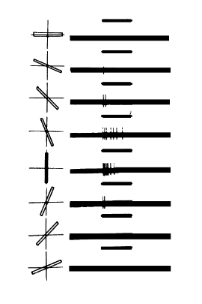
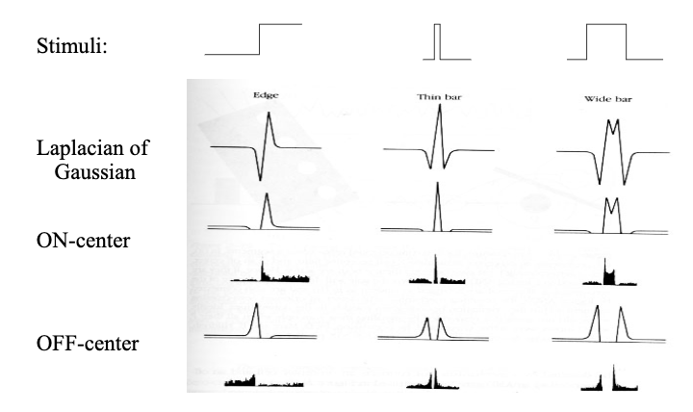
Retina tuned to contours
Hubel, D. H., and Wiesel, T. N. (1968). Receptive Fields and functional architecture of monkey striate cortex.

Slide 7
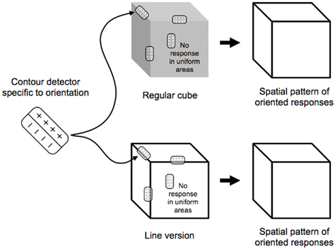
Lines vs Edges

Slide 8
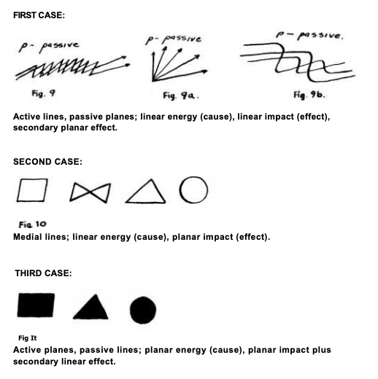
Klee, Paul. Pedagogical Sketchbook. 1925.

Slide 9
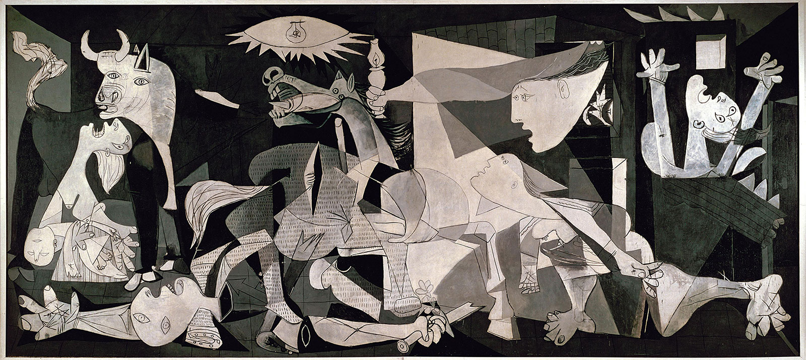
“Guernica” by Pablo Picasso. 1937.

Slide 10
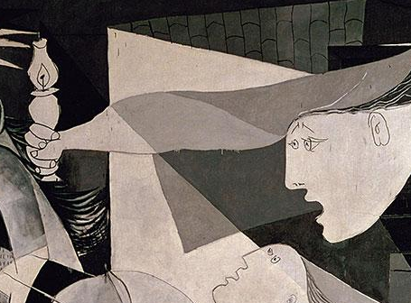
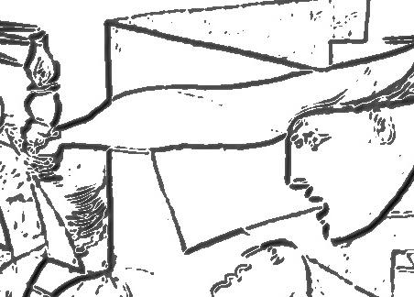

Slide 11
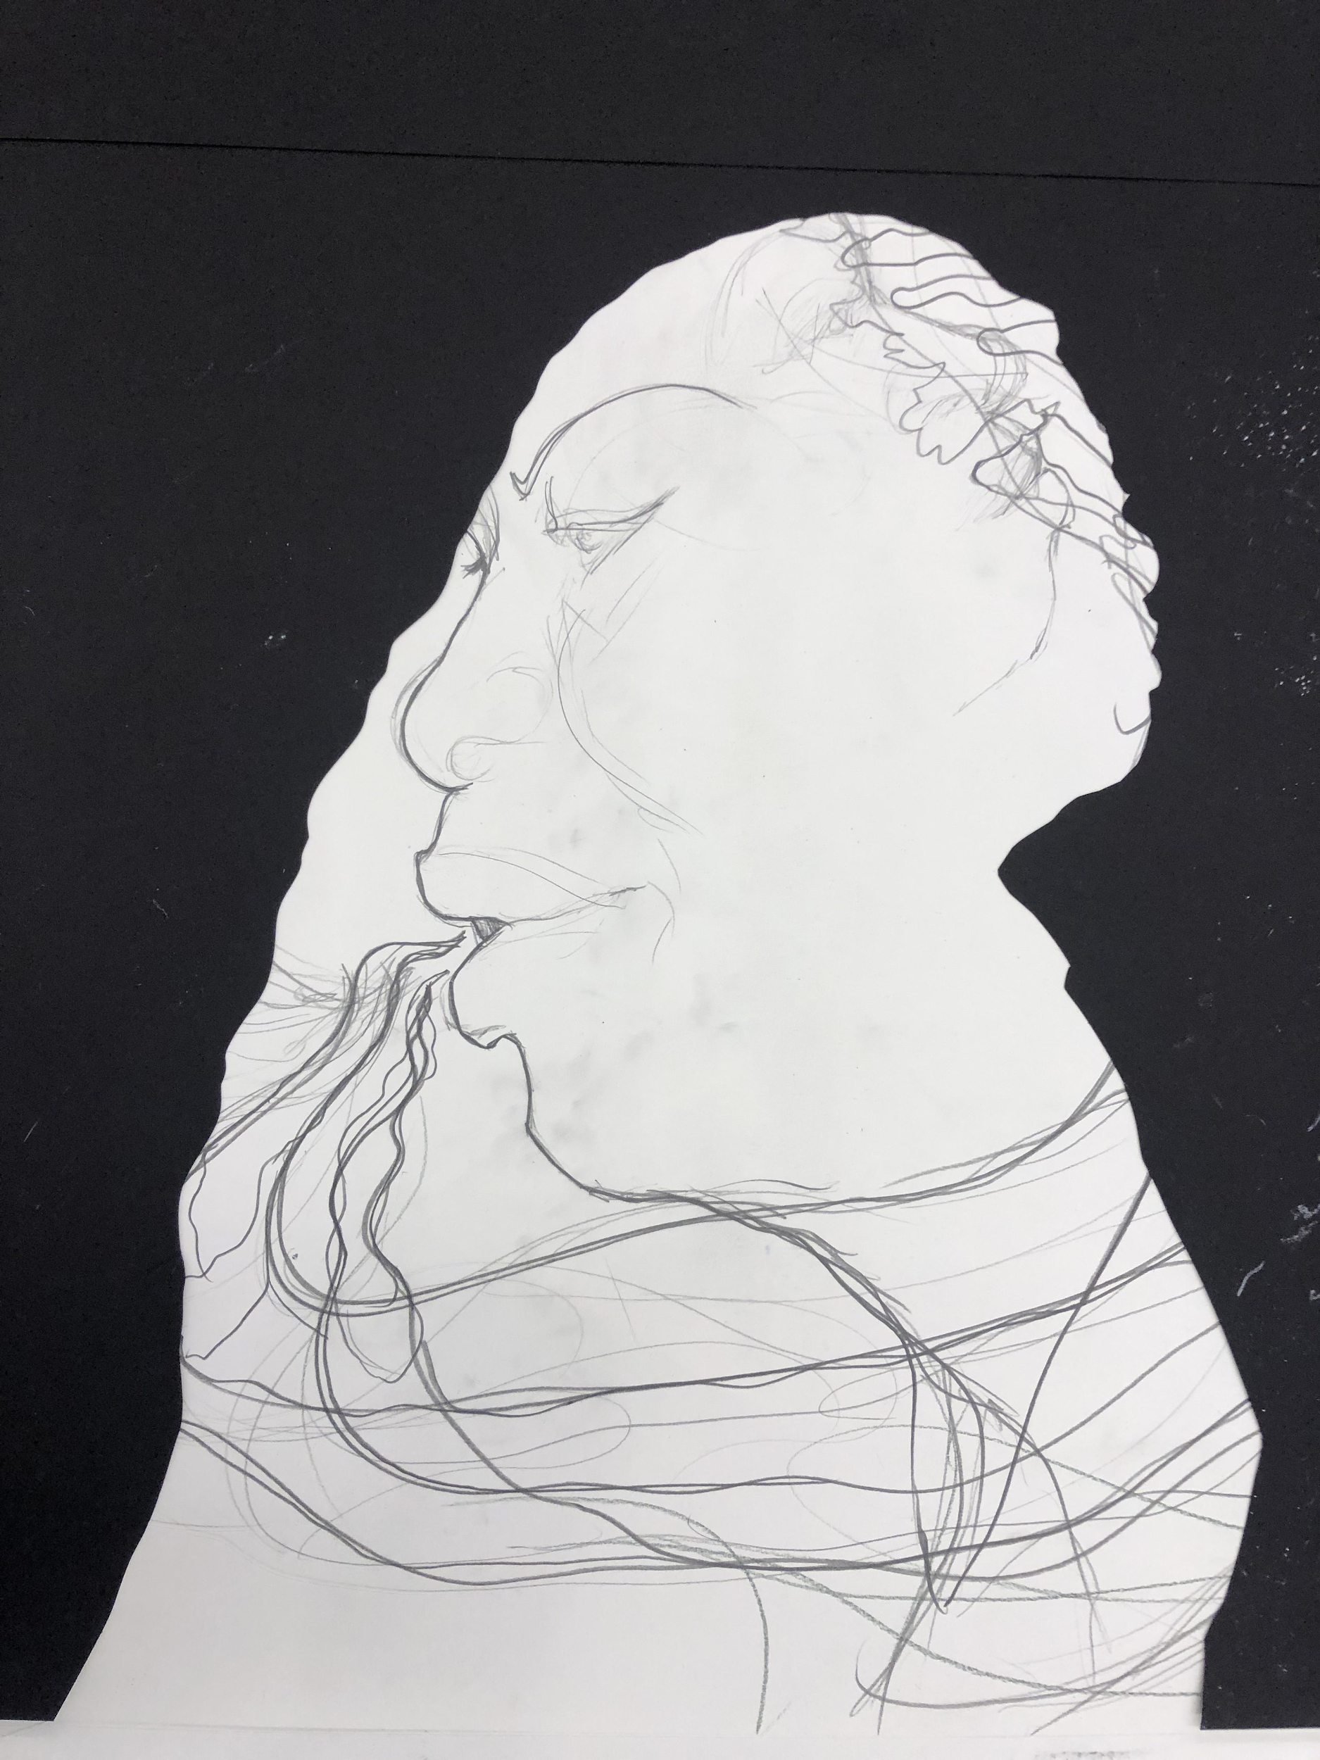
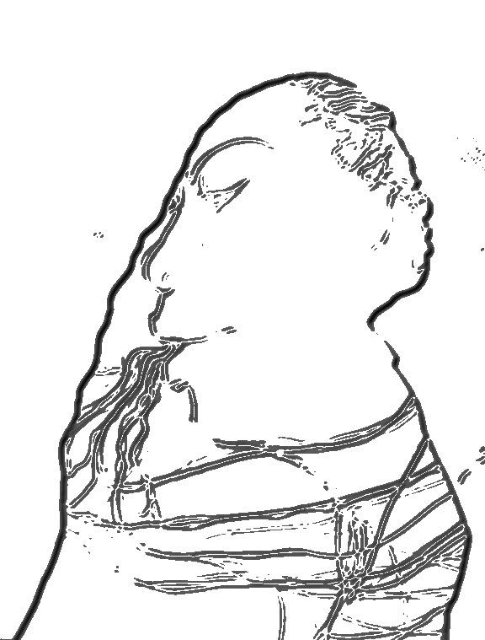
Prepatory drawing for “Quiet as It’s Kept” by Kara Walker. 2019.

Slide 12

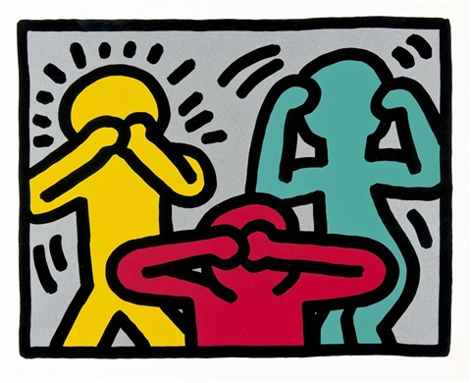
Cultural Conventions
Windows 10 Line Icons
“Untitled (from Pop Shop III)” by Keith Haring. 1989.

Slide 13
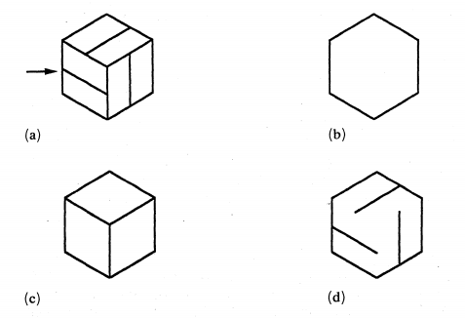

Slide 15
Infant Habituation Study
Yonas, A., and Arterberry, M. E. (1994). Infants perceive spatial structure specified by line junctions.

Slide 16
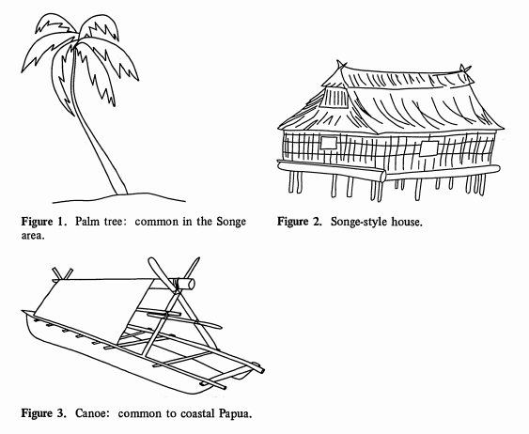
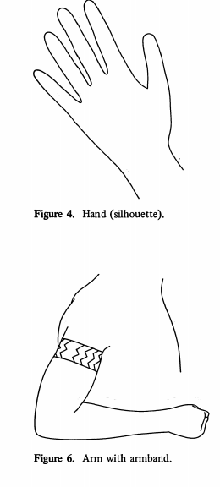
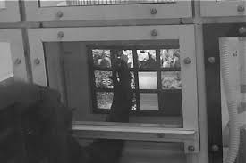
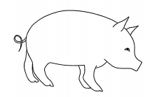
Innate Recognition
Infants, chimpanzees, groups without pictorial art
... recognize objects in line drawings

Slide 17
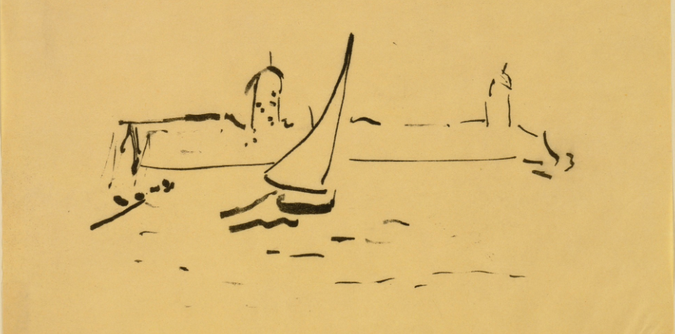
What is the mutual representation for natural images and lines in our brain?
“Port de Collioure” by Henri Matisse. 1907.

Slide 18

Object-recognition indifferent to source
V2 -> integrates color, motion, and form (“Processing of color, form, and motion in macaque area V2.” Gegenfurner et. al.. 1996.)
Onwards -> many detectors become indifferent to source attribute (“Form-cue invariant motion processing in primate visual cortex.” Albright, TD. 1992.)
Li et. al. “Photo-Sketching: Inferring Contour Drawings from Images.” 2019.

Slide 19
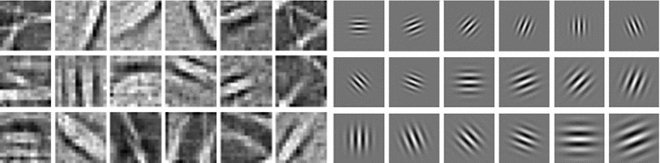
Sketch-a-Net: First Layer of CNN
Yu, Q., Yang, Y., Liu, F. et al. ‘Sketch-a-Net: A Deep Neural Network that Beats Humans.” 2017.

Slide 20
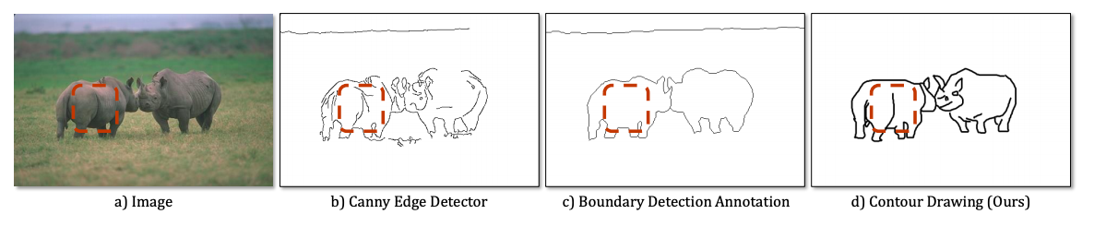
What are the important details/lines?
Li et. al. “Photo-Sketching: Inferring Contour Drawings from Images.” 2019.

Slide 21
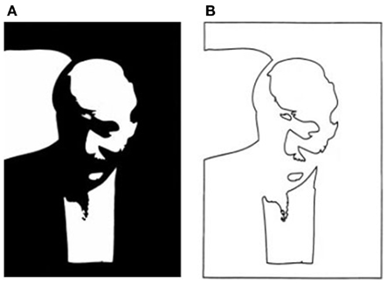
Which lines?

Slide 22
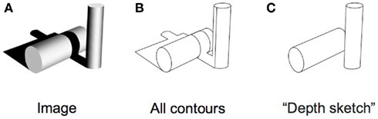
Object Contours

Slide 23
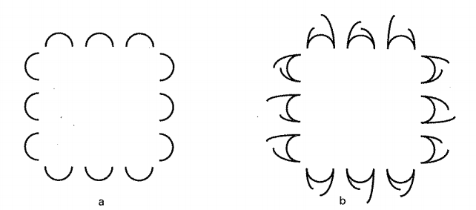
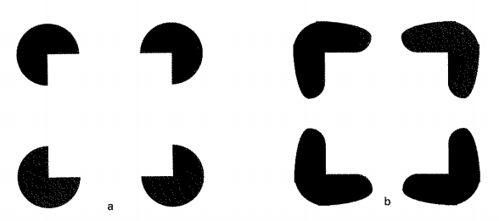
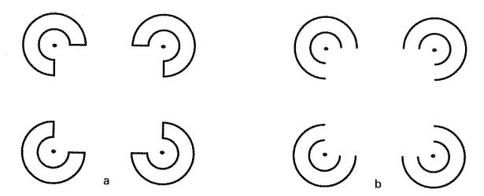
Albert, M. K., and Hoffman, D. D. (1995). “Genericity in spatial vision,”

Slide 24
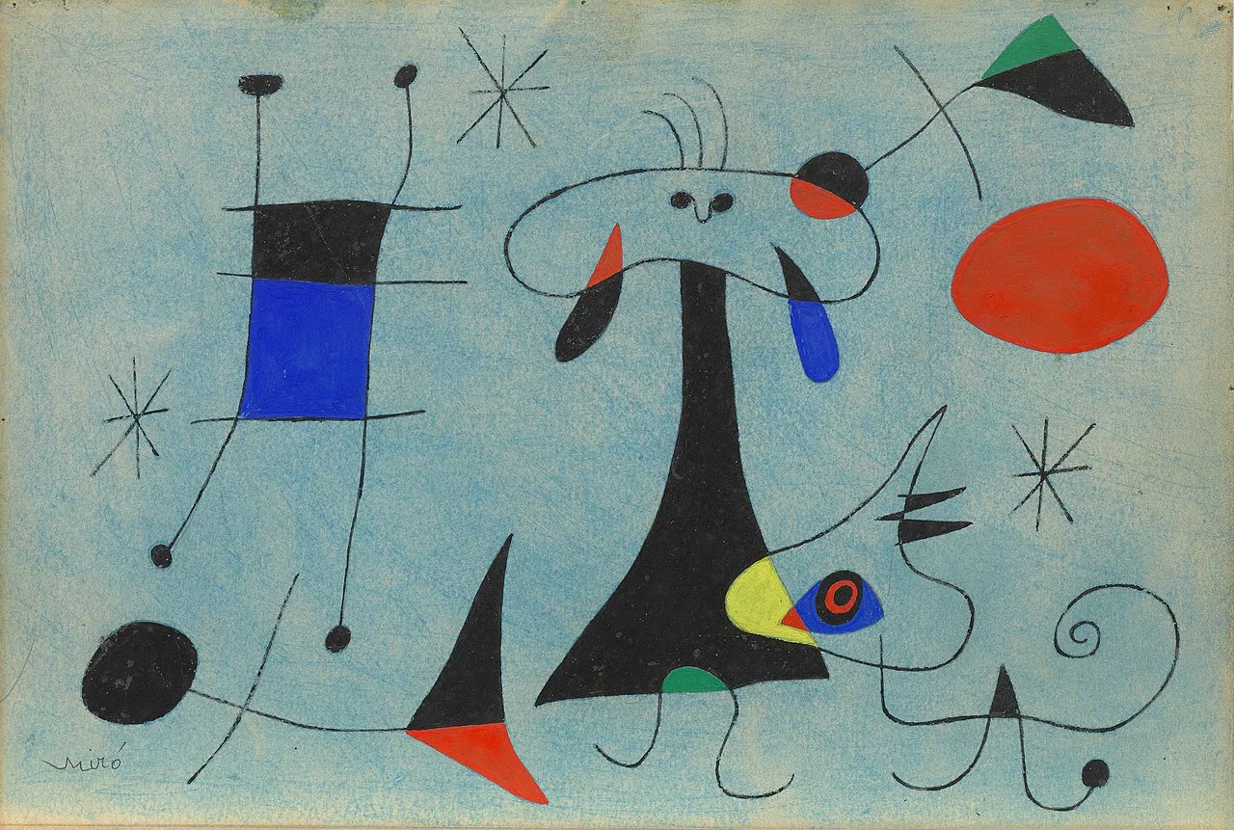
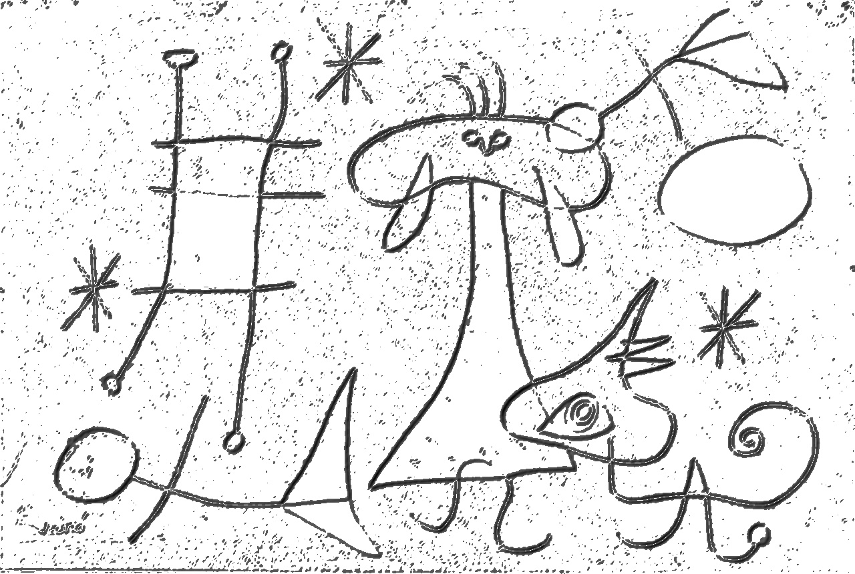
Art is the search for the alphabet of the mind.
-Joan Miró
Notes:
“The Hunter (Catalan Landscape)” by Joan Miró (1923-24)
https://www.nytimes.com/2019/03/14/arts/design/miro-review-moma.html

Slide 25
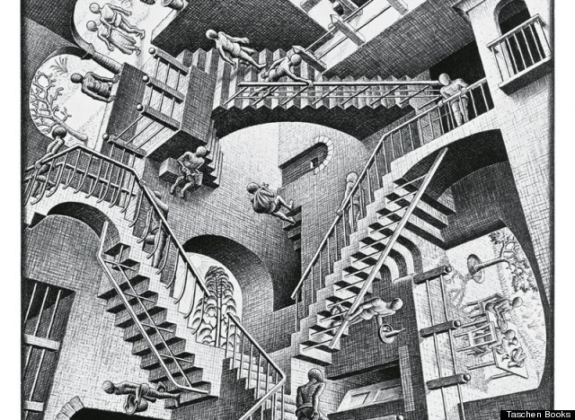
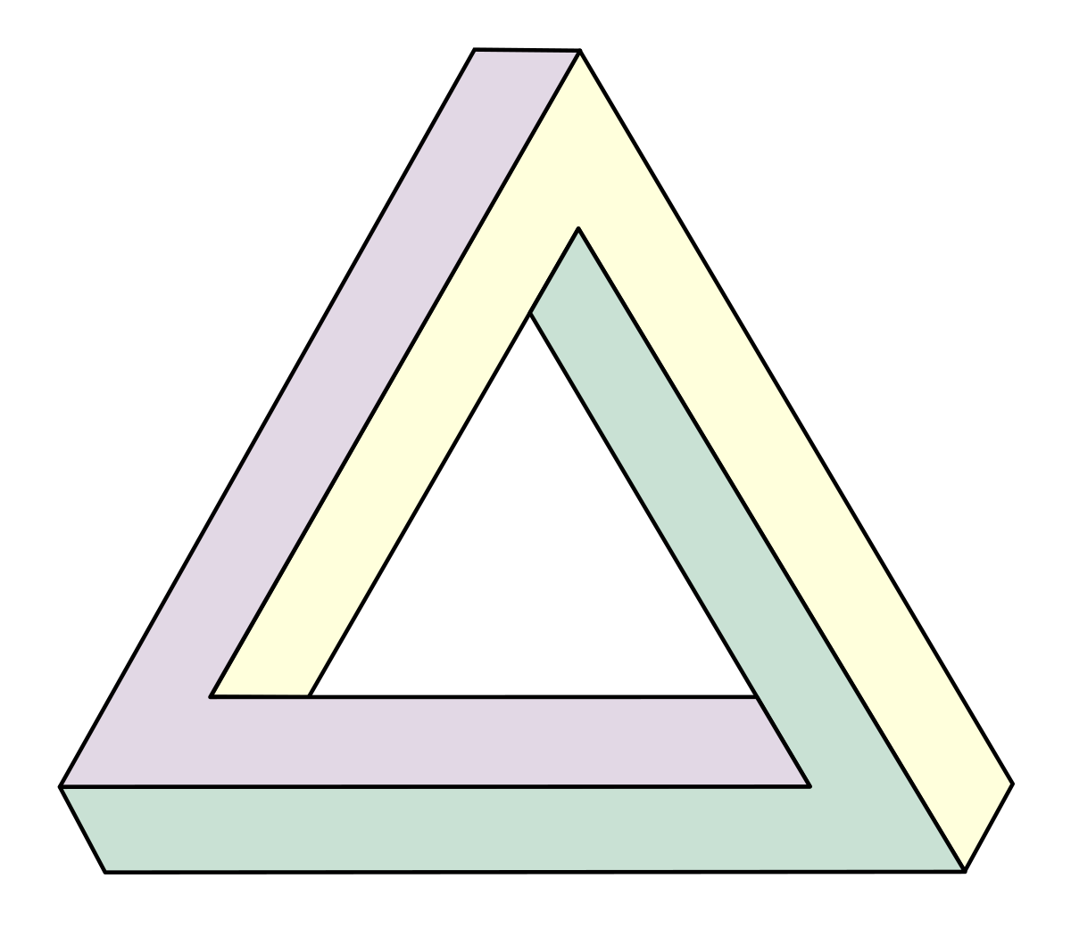
Artists and visual cognition
“Penrose triangle” by Oscar Reutersvärd. 1934.
“Relativity” by M.C. Escher. 1953.

Slide 26
Local interpretations from junctions
-Outside cubes give impression of line with ‘X’ joints.
-Middle cube gives impression of edge with ‘T’ joints.
Kennedy, J. M. (1974). A Psychology of Picture Perception.

Slide 27
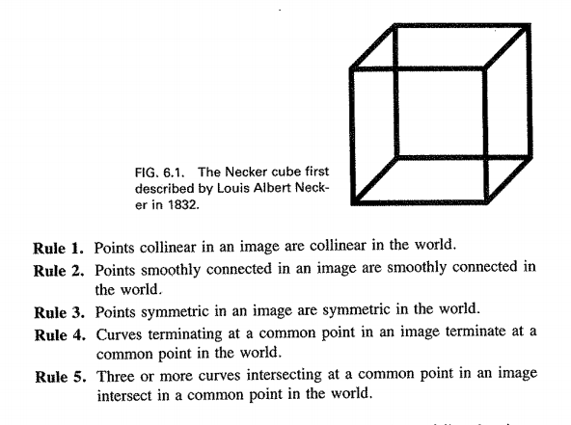
Albert, M. K., and Hoffman, D. D. (1995). “Genericity in spatial vision,”

Slide 28
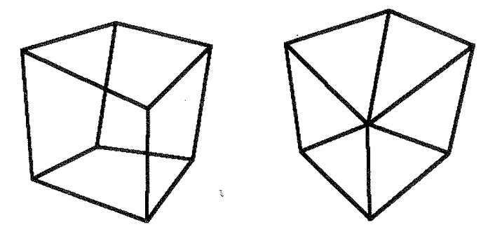
Albert, M. K., and Hoffman, D. D. (1995). “Genericity in spatial vision,”

Slide 29
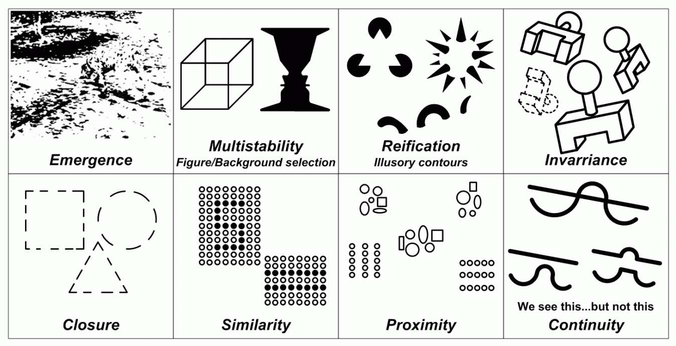
Gestalt Psychology
Source: http://braungardt.trialectics.com/sciences/psychology/gestalt-psychology-2/

Slide 30
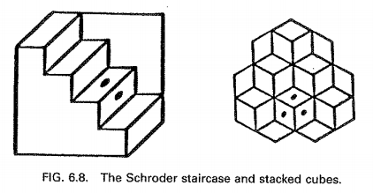

Slide 31
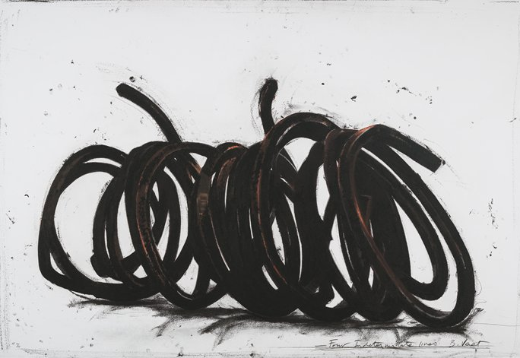
“Four Indeterminate Lines” by Bernar Venet. 2014.

Slide 32
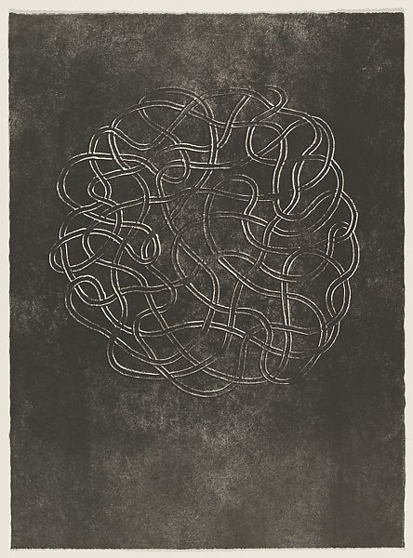
“the fascination of the maze… must surely rest on the difficulty of knowing at a single glance whether it is open or closed.”
Harold Cohen
“Line Involvements” by Anni Albers. 1964.

Slide 33
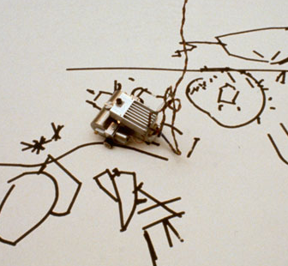
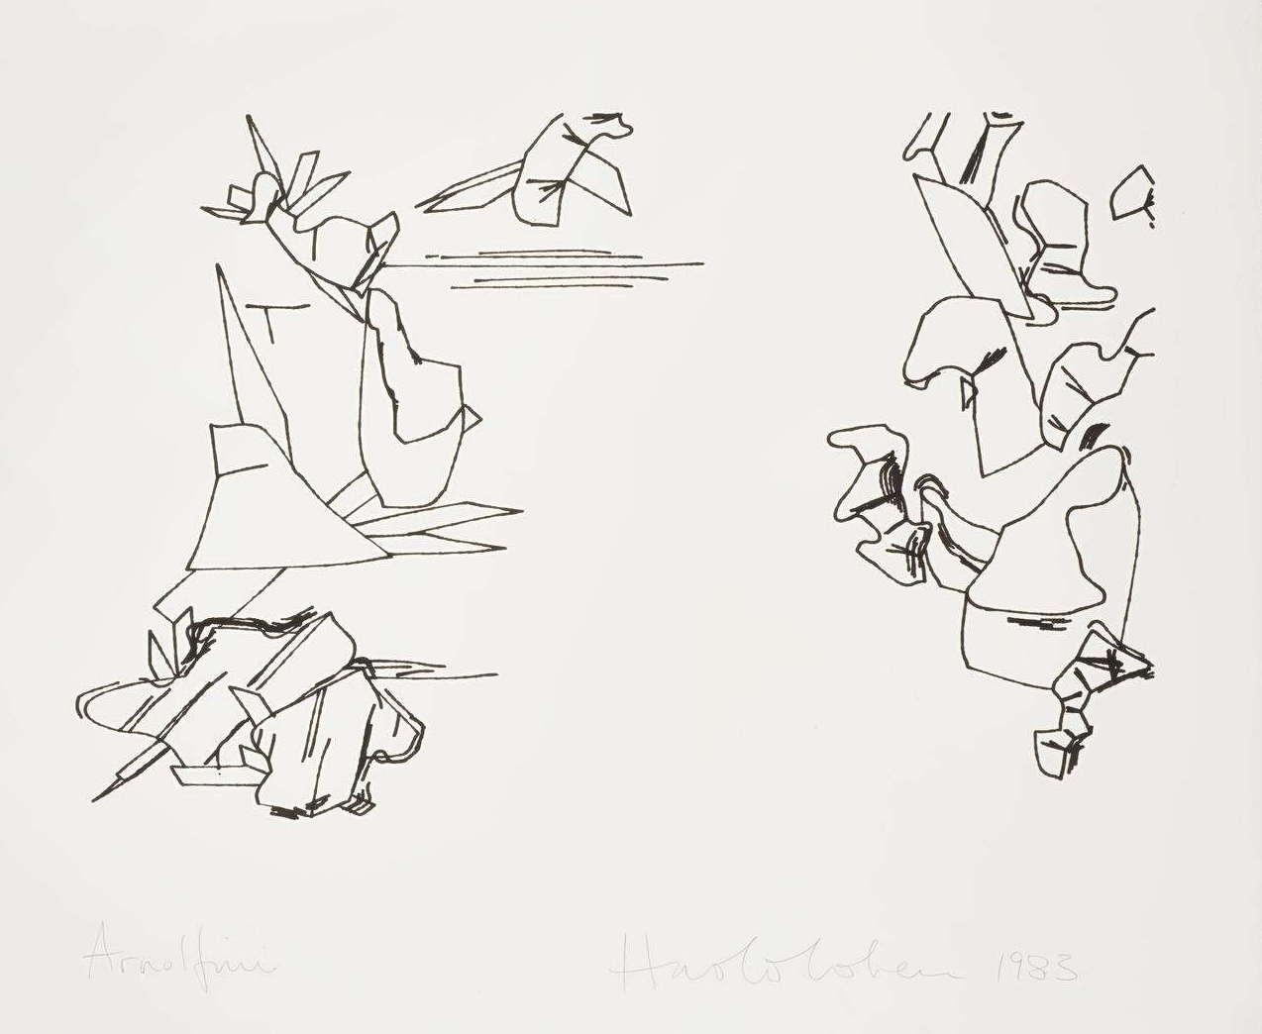
AARON. Harold Cohen. 1973-2016.

Slide 34

Familiar Prototypes

Slide 35
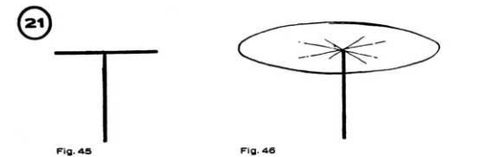
Klee, Paul. Pedagogical Sketchbook. 1925.

Slide 36
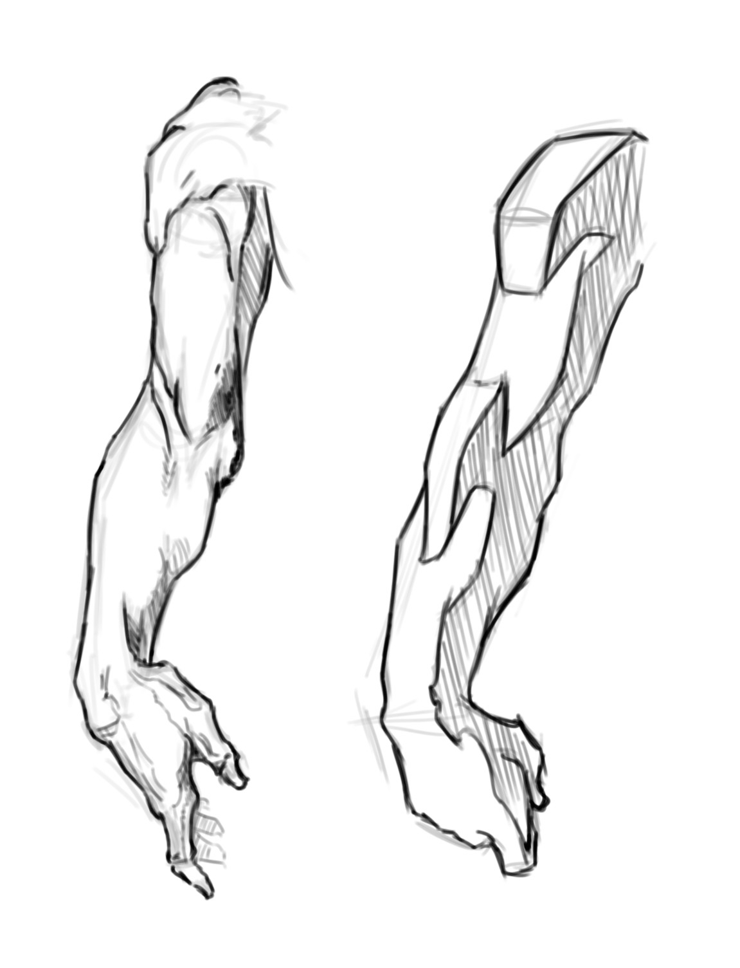
“Indeed it is very far from accurate to say that we see with our eyes. The eye is blind but for the idea behind the eye. It is the idea behind the eye that makes it different from a photographic plate-- that pricks out some parts with emphasis and censors other parts. We see with the idea, and only through the eye.”
George Bridgman, 1920

Slide 37
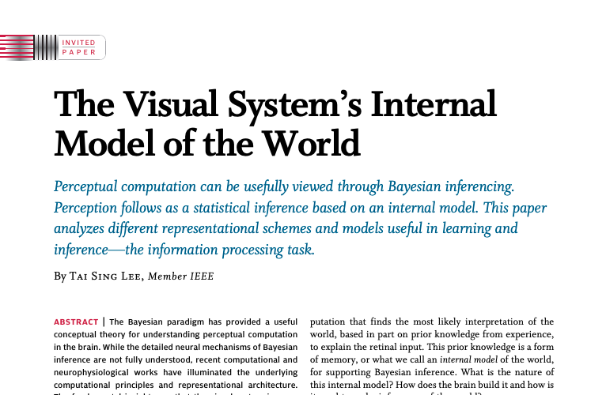

Slide 38
What do line drawings reveal about the visual brain?
...They tell us about our internal representation of images.

Slide 39
Works Cited
Albert, M. K., and Hoffman, D. D. (1995). “Genericity in spatial vision,” in Geometric Representations of Perceptual Phenomena: Papers in Honor of Tarow Indow on His 70th Birthday, eds D. Hoffman, R. D. Luce, M. D’Zmura, G. Iverson, and A. K. Romney (New York: Lawrence Erlbaum), 95–112.
Biederman, I., and Ju, G. (1988). Surface versus edge-based determinants of visual recognition. Cogn. Psychol. 20, 38–64.
Hubel, D. H., and Wiesel, T. N. (1968). Receptive Fields and functional architecture of monkey striate cortex. J. Neurosci. 195, 215–243.
Kennedy, J. M. (1974). A Psychology of Picture Perception. San Francisco: Jossey-Bass.
Kennedy, J. M., and Ross, A. S. (1975). Outline picture perception by the Songe of Papua. Perception 4, 391–406.
Sayim B and Cavanagh P (2011) What line drawings reveal about the visual brain. Front. Hum. Neurosci. 5:118. doi: 10.3389/fnhum.2011.00118
Tanaka, M. (2007). Recognition of pictorial representations by chimpanzees (Pan troglodytes). Anim. Cogn. 10, 169–179.
Yonas, A., and Arterberry, M. E. (1994). Infants perceive spatial structure specified by line junctions. Perception 23, 1427–1435.
Yu, Q., Yang, Y., Liu, F. et al. ‘Sketch-a-Net: A Deep Neural Network that Beats Humans.” Int J Comput Vis (2017) 122: 411. https://doi.org/10.1007/s11263-016-0932-3
Zorich, Zach. (2016). “New Dates for the Oldest Cave Paintings.” Archeology.

